Slide 1
Smart Mess Management Sys tem
Smarter meal planning that cuts waste, saves money, and keeps every plate full with less hassle and more impact.

Slide 2
The Food Waste Crisis in Institutional Kitchens
The Challenge
The Consequences
College messes and institutional kitchens face an unpredictable challenge daily. Student attendance for meals varies dramatically across breakfast, lunch, and dinner periods, making it nearly impossible to plan portions accurately.
This uncertainty leads to massive overproduction. Kitchens consistently cook more than needed, resulting in severe financial losses for institutions and creating a significant environmental footprint that contradicts campus sustainability goals.

Slide 3
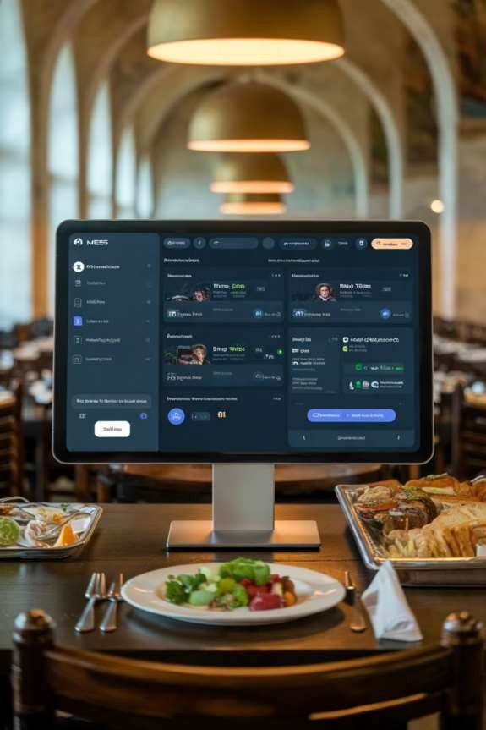

Introducing Smart Mess
Centralized Platform
A unified web-based system connecting all stakeholders in real-time
Data-Driven Forecasting
Machine learning algorithms replace guesswork with precision predictions
Perfect Portions
Cook exactly what's needed, eliminating overproduction waste

Slide 4
How Smart Mess Works
Role-based access ensures seamless coordination across all stakeholders:
Administrators
Comprehensive analytics dashboard tracks waste trends over 7-day deltas and triggers automated alerts to kitchen staff when adjustments are needed.
Kitchen Staff
Live dashboard displays exact portion predictions and receives real-time SMS alerts via Twilio integration, ensuring they know precisely what to prepare.
Students
Mobile-friendly portal for one-tap
meal pre-registration today. Students indicate which meals they'll attend with a single tap on
their phone.

Slide 5
The Brains Behind the System
Weighted Prediction Algorithm
Our forecasting model combines multiple data sources using intelligent
weighting:
50%
Live Registrations
Today's real-time pre-registrations
capture immediate intent
30%
Recent Trends
Average attendance over last 7 days
identifies patterns
20%
Historical Patterns
Same weekday last week data captures
recurring cycles

Slide 6

Technology S tack
Backend
Built with Node.js and Express for robust server-side handling
Frontend
HTML, CSS, and JavaScript create responsive, user-friendly
interfaces
Visualization
Chart.js enables real-time data dashboards with predicted vs.
actual waste deltas
Integration
Twilio API sends automated SMS alerts to kitchen staff phones

Slide 7

Sys tem Architecture
How students, administrators, and kitchen staff connect through a central prediction engine to generate real-time alerts and operational insights.
S tudents Portal
Mobile registrations and
usage data
Prediction E ngine
Central hub for real-time
predictions
S ys tem Architecture
Hub
K itchen S taff
Das hboard
Operational alerts and meal
forecasts
Adminis trators
Analytics
Dashboards for trends and
reports
Data flow: Students submit mobile registrations, the prediction engine processes weighted inputs, and outputs flow to kitchen staff and administrators. SMS alerts are delivered to staff through Twilio when demand changes require action.

Slide 8
Thank You
Team Leader
Team Members
Anil Mahto
Sourav Suman
Ayan Parwez
Rajveer Singh
View our project on GitHub

